Slide 1
Lab on Cell-free Synthetic Biology - EE-490(j)
Prof. Sebastian Maerkl
30.09.2025

Slide 2
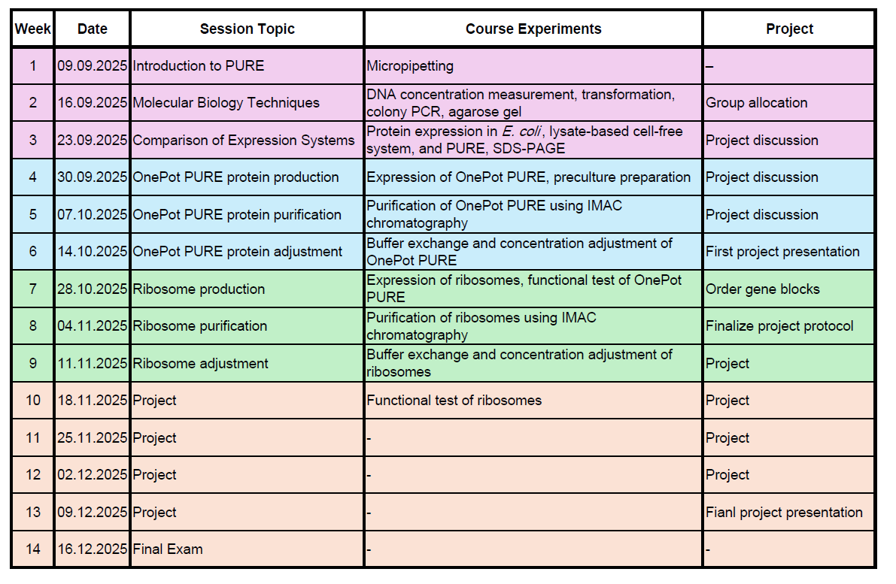
Course schedule

Slide 3
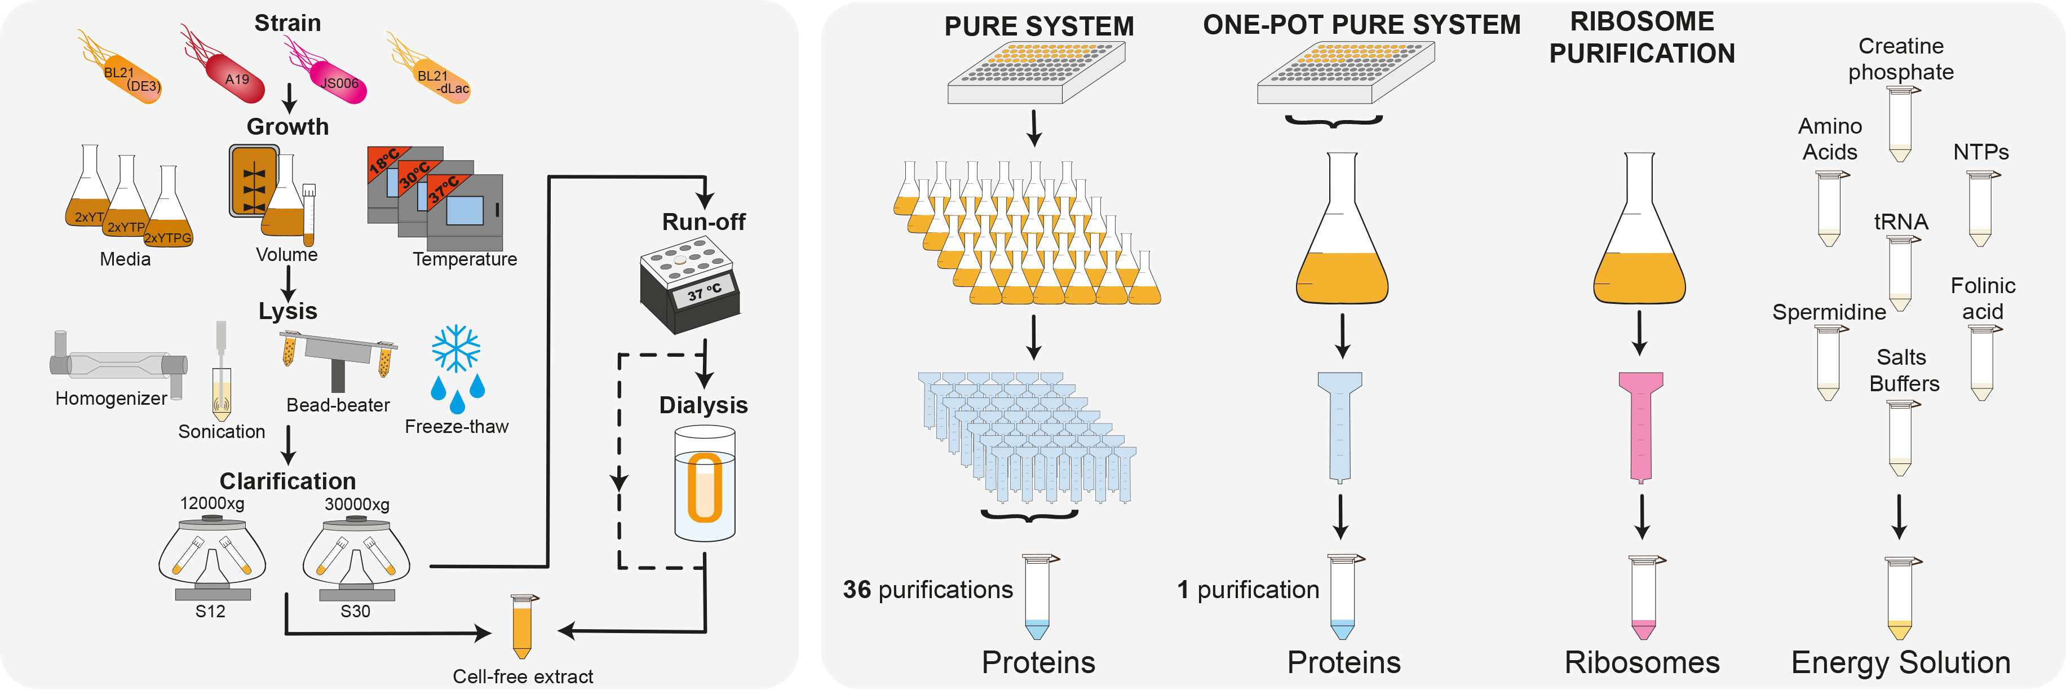
Lysate vs PURE
Lysate
PURE
adapted from: Laohakunakorn et al., Frontiers in Bioengineering and Biotechnology, 2020

Slide 4
PURE
Non-ribosomal proteins
36 non-ribosomal proteins
Ribosomes
tRNAs
Small molecules
Shimizu, Yoshihiro, et al. "Cell-free translation reconstituted with purified components." Nature biotechnology 19.8 (2001): 751-755

Slide 5
Table of PURE proteins
Addgene | Number | Protein | Protein name | Category | Role | Size [kDa] | Vector | Strain
#124103 | 1 | AlaRS | Alanyl-tRNA synthetase | tRNA Charging (AARS) | Charges tRNAᵃˡᵃ with alanine | 96 | pQE30 | M15
#124104 | 2 | ArgRS | Arginyl-tRNA synthetase | tRNA Charging (AARS) | Charges tRNAᵃʳᵍ with arginine | 64.7 | pET16b | BL21(DE3)
#124105 | 3 | AsnRS | Asparaginyl-tRNA synthetase | tRNA Charging (AARS) | Charges tRNAᵃˢⁿ with asparagine | 52.6 | pQE30 | M15
#124106 | 4 | AspRS | Aspartate-tRNA synthetase | tRNA Charging (AARS) | Charges tRNAᵃˢᵖ with aspartate | 65.9 | pET21a | BL21(DE3)
#124107 | 5 | CysRS | Cysteinyl-tRNA synthetase | tRNA Charging (AARS) | Charges tRNAᶜʸˢ with cysteine | 52.2 | pET21a | BL21(DE3)
#124108 | 6 | GlnRS | Glutaminyl-tRNA synthetase | tRNA Charging (AARS) | Charges tRNAᵍˡⁿ with glutamine | 58.6 | pET21a | BL21(DE3)
#124109 | 7 | GluRS | Glutamyl-tRNA synthetase | tRNA Charging (AARS) | Charges tRNAᵍˡᵘ with glutamate | 53.8 | pET21a | BL21(DE3)
#124110 | 8 | GlyRS | Glycyl-tRNA synthetase | tRNA Charging (AARS) | Charges tRNAᵍˡʸ with glycine | 34.8 & 76.8 | pET21a | BL21(DE3)
#124111 | 9 | HisRS | Histidyl-tRNA synthetase | tRNA Charging (AARS) | Charges tRNAʰⁱˢ with histidine | 47 | pET21a | BL21(DE3)
#124112 | 10 | IleRS | Isoleucyl-tRNA synthetase | tRNA Charging (AARS) | Charges tRNAⁱˡᵉ with isoleucine | 104.3 | pET21a | BL21(DE3)
#124113 | 11 | LeuRS | Leucyl-tRNA synthetase | tRNA Charging (AARS) | Charges tRNAˡᵉᵘ with leucine | 97.2 | pET21a | BL21(DE3)
#124114 | 12 | LysRS | Lysyl-tRNA synthetase | tRNA Charging (AARS) | Charges tRNAˡʸˢ with lysine | 76.3 | pET21a | BL21(DE3)
#124115 | 13 | MetRS | Methionine-tRNA ligase | tRNA Charging (AARS) | Charges tRNAᵐᵉᵗ with methionine | 57.8 | pET21a | BL21(DE3)
#124116 | 14 | PheRS | Phenylalanyl-tRNA synthetase | tRNA Charging (AARS) | Charges tRNAᵖʰᵉ with phenylalanine | 36.8 & 87.4 | pQE30 | M15
#124117 | 15 | ProRS | Prolyl-tRNA synthetase | tRNA Charging (AARS) | Charges tRNAᵖʳᵒ with proline | 63.7 | pET21a | BL21(DE3)
#124118 | 16 | SerRS | Seryl-tRNA synthetase | tRNA Charging (AARS) | Charges tRNAˢᵉʳ with serine | 48.4 | pET21a | BL21(DE3)
#124119 | 17 | ThrRS | Threonyl-tRNA synthetase | tRNA Charging (AARS) | Charges tRNAᵗʰʳ with threonine | 74 | pQE30 | M15
#124120 | 18 | TrpRS | Tryptophanyl-tRNA synthetase | tRNA Charging (AARS) | Charges tRNAᵗʳᵖ with tryptophan | 37.4 | pET21a | BL21(DE3)
#124121 | 19 | TyrRS | Tyrosyl-tRNA synthetase | tRNA Charging (AARS) | Charges tRNAᵗʸʳ with tyrosine | 47.5 | pET21a | BL21(DE3)
#124122 | 20 | ValRS | Valyl-tRNA synthetase | tRNA Charging (AARS) | Charges tRNAᵛᵃˡ with valine | 108.2 | pET21a | BL21(DE3)
#124123 | 21 | IF1 | Initiation factor 1 | Translation – Initiation | Stabilizes the A site to help initiation complex formation | 8 | pQE30 | M15
#124124 | 22 | IF2 | Initiation factor 2 | Translation – Initiation | Binds fMet-tRNA to ribosome; GTP-dependent | 97.4 | pQE30 | M15
#124125 | 23 | IF3 | Initiation factor 3 | Translation – Initiation | Prevents premature 50S binding; ensures fidelity | 20.6 | pQE30 | M15
#124126 | 24 | EF-G | Elongation factor G | Translation – Elongation | Catalyzes translocation of ribosome along mRNA | 77.6 | pQE60 | M15
#124127 | 25 | EF-Tu | Elongation factor Tu | Translation – Elongation | Delivers aminoacyl-tRNAs to the A site | 43.3 | pQE30 | M15
#124128 | 26 | EF-Ts | Elongation factor Ts | Translation – Elongation | Regenerates EF-Tu–GTP from EF-Tu–GDP | 30.4 | pQE60 | M15
#124129 | 27 | RF1 | Release factor 1 | Translation – Termination | Recognizes UAG/UAA stop codons, releases peptide | 40.5 | pQE30 | M15
#124130 | 28 | RF2 | Release factor 2 | Translation – Termination | Recognizes UGA/UAA stop codons, releases peptide | 41.2 | pET15b | BL21(DE3)
#124131 | 29 | RF3 | Release factor 3 | Translation – Termination | Stimulates RF1/RF2 recycling | 59.6 | pQE30 | M15
#124132 | 30 | RRF | Ribosome recycling factor | Ribosome Recycling | Promotes disassembly of post-termination complex | 20 | pQE30 | M15
#124133 | 31 | MTF | Methionyl-tRNA formyltransferase | tRNA Modification | Formylates Met-tRNAᶠᴹᵉᵗ (bacterial initiation) | 34.3 | pET21a | BL21(DE3)
#124134 | 32 | CK | Creatine kinase | Energy Regeneration | Regenerates ATP from creatine phosphate | 37.7 | pQE30 | M15
#118977 | 33 | MK | Adenylate kinase (Myokinase) | Energy Regeneration | Converts 2 ADP ↔ ATP + AMP | 21.7 | pET21a | BL21(DE3)
#124136 | 34 | NDK | Nucleotide diphosphate kinase | Energy Regeneration | Balances NTPs (e.g., GDP + ATP → GTP + ADP) | 15.3 | pET21a | BL21(DE3)
#118978 | 35 | PPiase | Inorganic pyrophosphatase | Energy Regeneration | Degrades PPi to drive NTP synthesis forward | 32.3 | pET21a | BL21(DE3)
#124138 | 36 | T7 RNAP | T7 RNA polymerase | Transcription | Transcribes DNA into mRNA using T7 promoter | 98.9 | pQE30 | M15

Slide 6
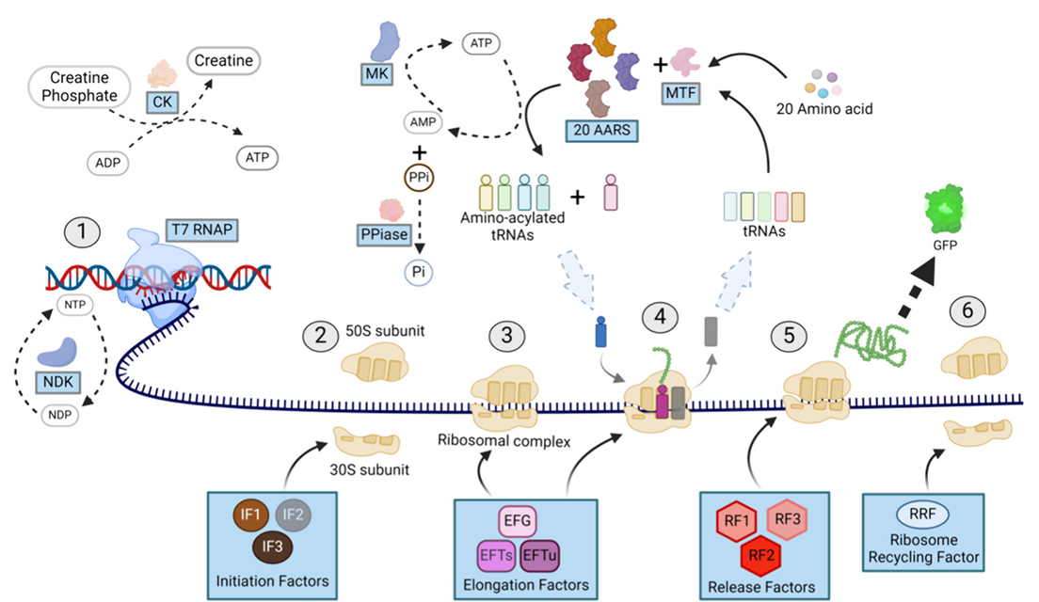
PURE
Ganesh & Maerkl, ACS Synth. Biol., 2024

Slide 7
Set up a PURE reaction
DNA
Ribosome
36 non-ribosomal
protein
Energy Solution

Slide 8
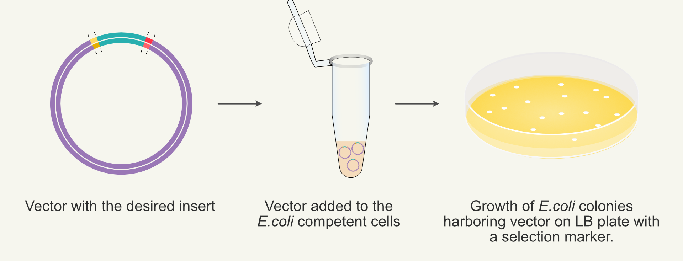
OnePot PURE
36 transformations

Slide 9

OnePot PURE
adapted from: Laohakunakorn et al., Frontiers in Bioengineering and Biotechnology, 2020

Slide 10
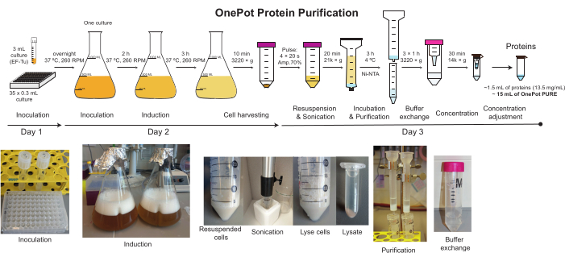
OnePot PURE production

